Slide 1
THE LIFE OF CHRIST
PART 36

Slide 2
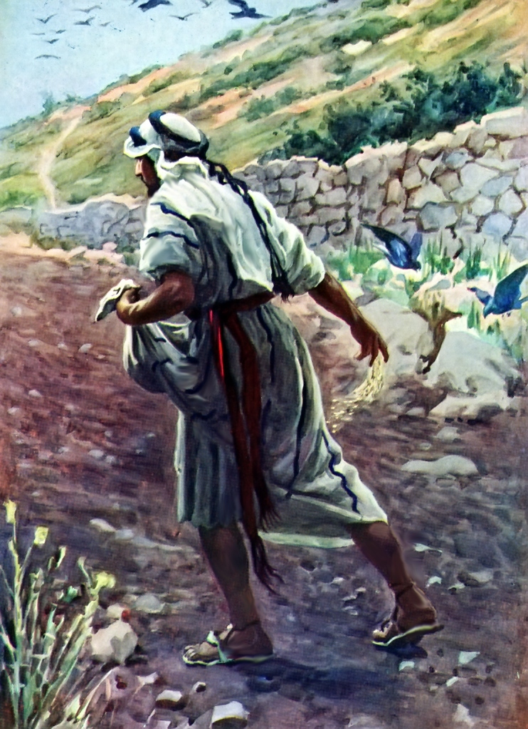
THE PARABLE OF THE SOWER found in: Mt. 13:3-8, 18-23, Mk. 4:4-8, 14-21, Lk. 8: 5-8, 11-15.

Slide 3
Matthew 13:1 On the same day Jesus went out of the house and sat by the sea. ² And great multitudes were gathered together to Him, so that He got into a boat and sat; and the whole multitude stood on the shore. ³ Then He spoke many things to them in parables, saying: "Behold, a sower went out to sow. ⁴ "And as he sowed, some seed fell by the wayside; and the birds came and devoured them. ⁵ "Some fell on stony places, where they did not have much earth; and they immediately sprang up because they had no depth of earth. ⁶ "But when the sun was up they were scorched, and because they had no root they withered away. ⁷ "And some fell among thorns, and the thorns sprang up and choked them. ⁸ "But others fell on good ground and yielded a crop: some a hundredfold, some sixty, some thirty. ⁹ "He who has ears to hear, let him hear!"

Slide 4
Matthew 13:10 And the disciples came and said to Him, "Why do You speak to them in parables?" ¹¹ He answered and said to them, "Because it has been given to you to know the mysteries of the kingdom of heaven, but to them it has not been given. ¹² "For whoever has, to him more will be given, and he will have abundance; but whoever does not have, even what he has will be taken away from him. ¹³ "Therefore I speak to them in parables, because seeing they do not see, and hearing they do not hear, nor do they understand.

Slide 5
¹⁴ "And in them the prophecy of Isaiah is fulfilled, which says: 'Hearing you will hear and shall not understand, And seeing you will see and not perceive; ¹⁵ For the hearts of this people have grown dull. Their ears are hard of hearing, And their eyes they have closed, Lest they should see with their eyes and hear with their ears, Lest they should understand with their hearts and turn, So that I should heal them.' ¹⁶ "But blessed are your eyes for they see, and your ears for they hear; ¹⁷ "for assuredly, I say to you that many prophets and righteous men desired to see what you see, and did not see it, and to hear what you hear, and did not hear it.

Slide 6
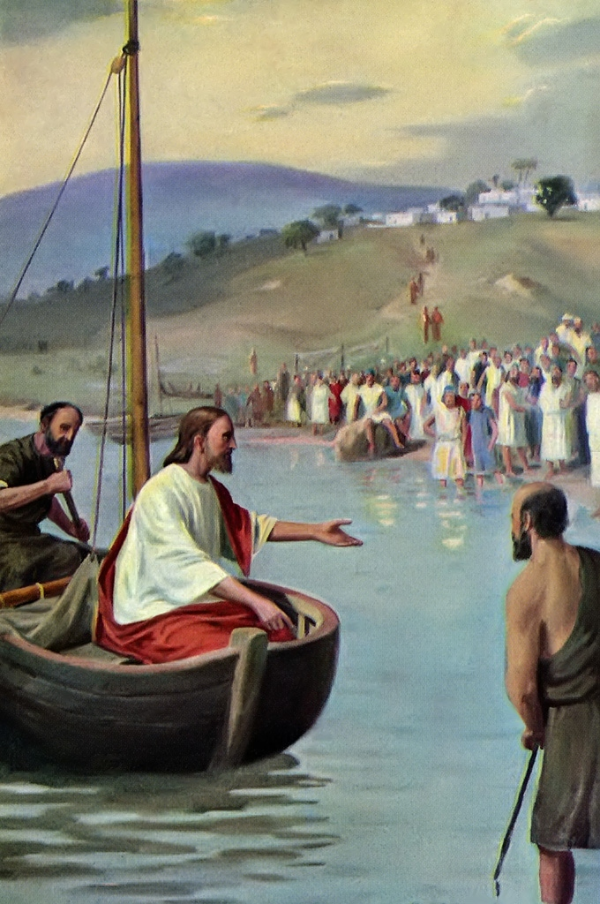
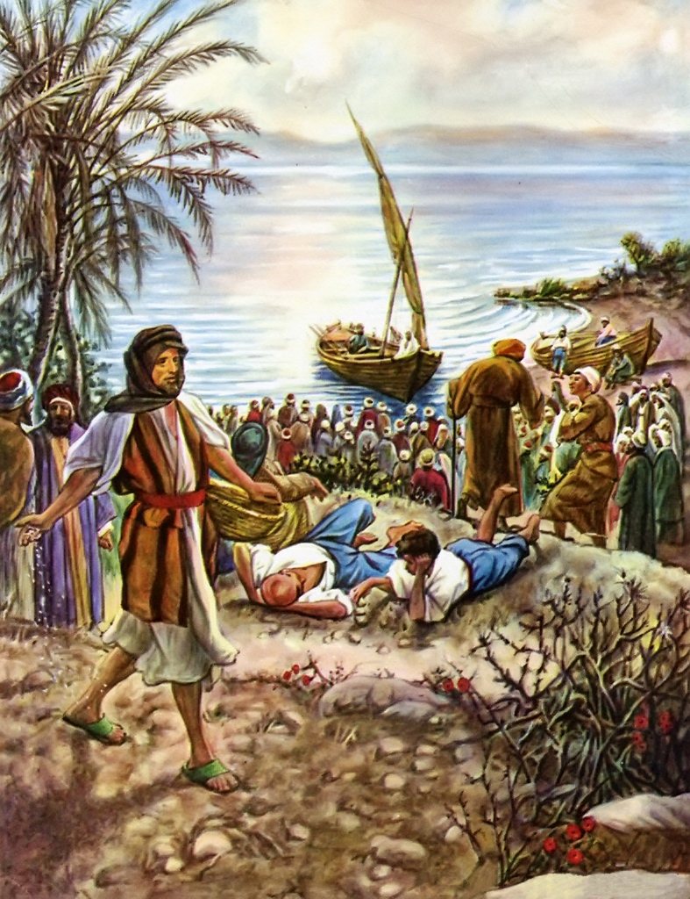

Slide 7
Matthew 13:18 " Therefore hear the parable of the sower: ¹⁹ "When anyone hears the word of the kingdom, and does not understand it, then the wicked one comes and snatches away what was sown in his heart. This is he who received seed by the wayside. ²⁰ "But he who received the seed on stony places, this is he who hears the word and immediately receives it with joy; ²¹ "yet he has no root in himself, but endures only for a while. For when tribulation or persecution arises because of the word, immediately he stumbles.

Slide 8
²² "Now he who received seed among the thorns is he who hears the word, and the cares of this world and the deceitfulness of riches choke the word, and he becomes unfruitful. ²³ "But he who received seed on the good ground is he who hears the word and understands it, who indeed bears fruit and produces: some a hundredfold, some sixty, some thirty."

Slide 9
Luke 8:11 The seed is the word of God.

Slide 10
1. We need to understand that God has just asked us to sow the word and allow Him to give the increase. As Paul said:
1 Corinthians 3:6 I planted, Apollos watered, but God gave the increase.

Slide 11
Isaiah 55:10 "For as the rain comes down, and the snow from heaven, And do not return there, But water the earth, And make it bring forth and bud, That it may give seed to the sower And bread to the eater, ¹¹ So shall My word be that goes forth from My mouth; It shall not return to Me void, But it shall accomplish what I please, And it shall prosper in the thing for which I sent it.

Slide 12
2. Unlike a sower who only plants certain times of the year, we must sow the Word of God all year long. As:
Ecclesiastes 11:4 He who observes the wind will not sow, And he who regards the clouds will not reap. ⁵ As you do not know what is the way of the wind, Or how the bones grow in the womb of her who is with child, So you do not know the works of God who makes everything. ⁶ In the morning sow your seed, And in the evening do not withhold your hand; For you do not know which will prosper, Either this or that, Or whether both alike will be good.

Slide 13
2 Timothy 4:2 Preach the word! Be ready in season and out of season. Convince, rebuke, exhort, with all longsuffering and teaching.

Slide 14
3. Sometimes others will reap what we have sown.

Slide 15
John 4:35 "Do you not say, 'There are still four months and then comes the harvest'? Behold, I say to you, lift up your eyes and look at the fields, for they are already white for harvest! ³⁶ "And he who reaps receives wages, and gathers fruit for eternal life, that both he who sows and he who reaps may rejoice together. ³⁷ "For in this the saying is true: 'One sows and another reaps.' ³⁸ "I sent you to reap that for which you have not labored; others have labored, and you have entered into their labors."

Slide 16
4. We must sow the seed with love that means having the right attitude. As Paul said:
2 Timothy 2:24 And a servant of the Lord must not quarrel but be gentle to all, able to teach, patient, ²⁵ in humility correcting those who are in opposition, if God perhaps will grant them repentance, so that they may know the truth, ²⁶ and that they may come to their senses and escape the snare of the devil, having been taken captive by him to do his will.
Ephesians 4:15 speaking the truth in love

Slide 17
5. We must believe in the seed.

Slide 18
1 Peter 1:24 "All flesh is as grass, And all the glory of man as the flower of the grass. The grass withers, And its flower falls away, ²⁵ But the word of the LORD endures forever." Now this is the word which by the gospel was preached to you.

Slide 19
Proverbs 16:18 Pride goes before destruction, And a haughty spirit before a fall.

Slide 20
Ephesians 4:17 This I say, therefore, and testify in the Lord, that you should no longer walk as the rest of the Gentiles walk, in the futility of their mind, ¹⁸ having their understanding darkened, being alienated from the life of God, because of the ignorance that is in them, because of the blindness of their heart; ¹⁹ who, being past feeling, have given themselves over to lewdness, to work all uncleanness with greediness.

Slide 21
Matthew 7:24 " Therefore whoever hears these sayings of Mine, and does them, I will liken him to a wise man who built his house on the rock: ²⁵ "and the rain descended, the floods came, and the winds blew and beat on that house; and it did not fall, for it was founded on the rock. ²⁶ "But everyone who hears these sayings of Mine, and does not do them, will be like a foolish man who built his house on the sand: ²⁷ "and the rain descended, the floods came, and the winds blew and beat on that house; and it fell. And great was its fall."

Slide 22
John 6:60 Therefore many of His disciples, when they heard this, said, "This is a hard saying; who can understand it?" 61 When Jesus knew in Himself that His disciples complained about this, He said to them, "Does this offend you? 62 "What then if you should see the Son of Man ascend where He was before? 63 "It is the Spirit who gives life; the flesh profits nothing. The words that I speak to you are spirit, and they are life. 64 "But there are some of you who do not believe." For Jesus knew from the beginning who they were who did not believe, and who would betray Him. 65 And He said, "Therefore I have said to you that no one can come to Me unless it has been granted to him by My Father." 66 From that time many of His disciples went back and walked with Him no more.

Slide 23
James 1:2 My brethren, count it all joy when you fall into various trials, ³ knowing that the testing of your faith produces patience. ⁴ But let patience have its perfect work, that you may be perfect and complete, lacking nothing.

Slide 24
Luke 10:38 Now it happened as they went that He entered a certain village; and a certain woman named Martha welcomed Him into her house. ³⁹ And she had a sister called Mary, who also sat at Jesus' feet and heard His word. ⁴⁰ But Martha was distracted with much serving, and she approached Him and said, "Lord, do You not care that my sister has left me to serve alone? Therefore tell her to help me." ⁴¹ And Jesus answered and said to her, "Martha, Martha, you are worried and troubled about many things. ⁴² "But one thing is needed, and Mary has chosen that good part, which will not be taken away from her."

Slide 25
1 Timothy 6:7 For we brought nothing into this world, and it is certain we can carry nothing out. ⁸ And having food and clothing, with these we shall be content. ⁹ But those who desire to be rich fall into temptation and a snare, and into many foolish and harmful lusts which drown men in destruction and perdition. ¹⁰ For the love of money is a root of all kinds of evil, for which some have strayed from the faith in their greediness, and pierced themselves through with many sorrows.

Slide 26
Matthew 6:33 "But seek first the kingdom of God and His righteousness, and all these things shall be added to you.

Slide 27
Notice the qualities of this type of a person.
1. They are able to hear the Word of God and understand it.
2. After hearing it, they accept it for what it says.
3 After they accept it, they hold fast to it and they never let it go.
4. Best of all, they produce fruit because they live by the Word of God and teach it to others.

Slide 28
Matthew 7:13 " Enter by the narrow gate; for wide is the gate and broad is the way that leads to destruction, and there are many who go in by it. ¹⁴ "Because narrow is the gate and difficult is the way which leads to life, and there are few who find it.

